Slide 1


Operation Analytics and Investigating Metric Spike
BY ABHISHEK AWARE

Slide 2
Project agenda
The project includes two distinct case studies:
Operational Analytics: This case focuses on analyzing job-related data, including metrics such as the total number of jobs reviewed, the 7-day rolling average for throughput, the percentage breakdown of languages used, and the identification of duplicate entries.
2.Metric Spike Investigation: This case involves examining key performance indicators, including user engagement trends, user growth rates, weekly retention figures, weekly engagement metrics, and email engagement statistics.
The findings in both cases were derived using SQL queries.

Slide 3
Approach
The necessary information was extracted using SQL queries after initially creating the database in SQL. Additionally, for the second case study, due to the large dataset, Excel was employed to generate charts for improved data visualization.

Slide 4
Tech-Stack Used
In the second case study, Microsoft Excel was utilized to create visualizations for better data interpretation.
MySQL was chosen for running the queries, as the language offers familiarity and ease of use due to prior experience.
Since I am in the process of learning Excel, I leveraged it to gain more practical, hands-on experience.

Slide 5
Case Study 1: Job Data Analysis
INSIGHTS

Slide 6
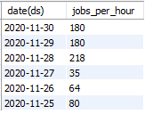
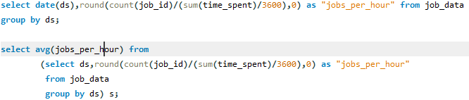

Insights: A. Jobs Reviewed Over Time
In November 2020, the number of jobs reviewed per hour each day fluctuated, showing increased activity on certain days and reduced activity on others.
Having overall126.1667 as average jobs per hour

Slide 7
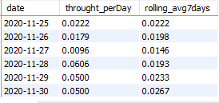
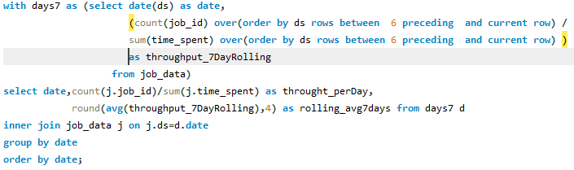
B. Throughput Analysis:
A 7-day rolling average is preferred as it smooths out daily throughput fluctuations, providing a clearer and more accurate representation of the overall trend.

Slide 8

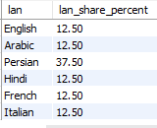
C. Language Share Analysis::
The language distribution over the past 30 days is fairly balanced, with Persian holding the largest share.

Slide 9


D. Duplicate Rows Detection:
The output returned empty as no duplicate rows were identified in the database.

Slide 10
Case Study 2: Investigating Metric Spike
INSIGHTS

Slide 11
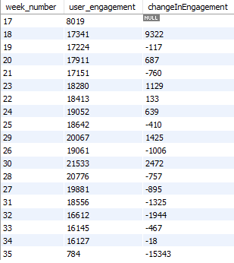
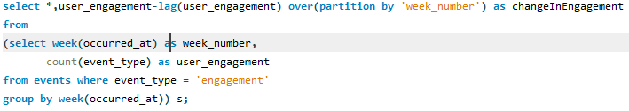
A. Weekly User Engagement:
User engagement appears to have reached its peak around week 30, with some fluctuations noted throughout the observed period.

Slide 12
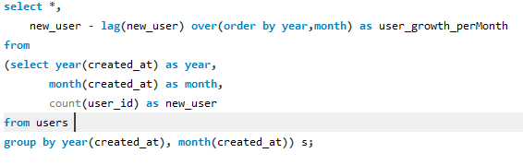
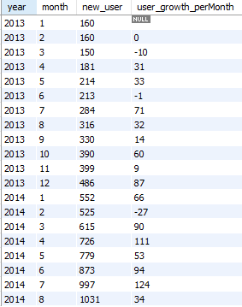
B. User Growth Analysis:
User growth has shown an overall positive trend over time, despite experiencing some fluctuations.

Slide 13
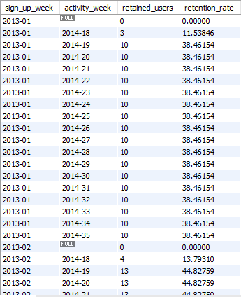
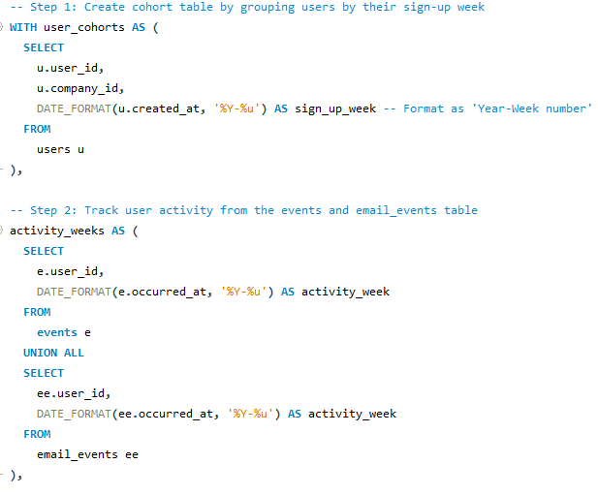
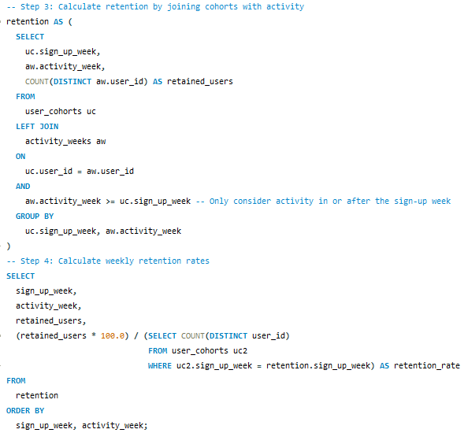
C. Weekly Retention Analysis:

Slide 14

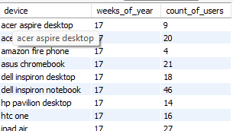
D. Weekly Engagement Per Device:
This is just a sample output; over 400 records have been generated in total.
Engagement levels fluctuate across various devices and weeks, with certain devices consistently demonstrating higher engagement compared to others.

Slide 15
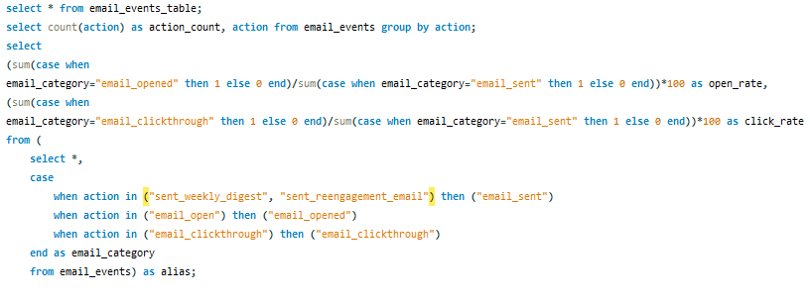

E. Email Engagement Analysis:
The email engagement metrics indicate an open rate of around 33.58% and a click-through rate of approximately 14.79%.

Slide 16
Result
This project was highly engaging, with its complexity adding to the sense of fulfillment upon completion.
I learned new concepts, including rolling averages and cohort retention analysis.
I incorporated Excel charts wherever possible and aim to use Excel more efficiently next time.
My skills in using window functions have improved significantly.

Slide 17
Thank You

